Slide 1
Formal Modeling and Software Configuration Management
Session 18
(Lecture)
Course : COMP6100/Software Engineering
Effective Period : Desember 2017

Slide 2
These slides have been adapted from
Pressman, R.S. (2015). Software Engineering : A Practioner's Approach. 8th ed. McGraw-Hill Companies.Inc, Americas, New York. ISBN : 978 1 259 253157. Chapter 28 and 29
Acknowledgement

Slide 3
LO 4 : Analyze the software project management and the proposed potential business project
Learning Objectives

Slide 4
Contents
Formal Modeling and Verification
The Cleanroom Process Model
Functional Specification
Design Refinement & Verification
Cleanroom Testing
Formal Methods
The Software Configuration
The SCM Process
Configuration Management for Web and MobilApps

Slide 5
Formal Modeling
and Verification
Cleanroom software engineering and formal methods
  Both demand a specialized specification approach and each applies a unique verification method.
  Both are quite rigorous and neither is used widely by the software engineering community.
If you must build “bullet-proof” software, these methods can help immeasurably.

Slide 6
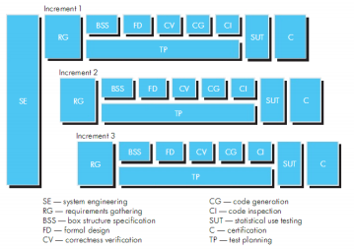
The Cleanroom
Process Model

Slide 7
The Cleanroom Strategy-I
The Cleanroom
Process Model
Increment Planning
  adopts the incremental strategy
Requirements Gathering
  defines a description of customer level requirements
Box Structure Specification
  describes the functional specification
Formal Design
  specifications (called “black boxes”) are iteratively refined (with an increment) to become analogous to architectural and procedural designs (called “state boxes” and “clear boxes,” respectively).
Correctness Verification
  verification begins with the highest level box structure (specification) and moves toward design detail and code using a set of “correctness questions.” If these do not demonstrate that the specification is correct, more formal (mathematical) methods for verification are used.

Slide 8
The Cleanroom Strategy-II
The Cleanroom
Process Model
Code Generation, Inspection and Verification
  the box structure specifications, represented in a specialized language, are transmitted into the appropriate programming language.
Statistical Test Planning
  a suite of test cases that exercise of “probability distribution” of usage are planned and designed
Statistical Use Testing
  execute a series of tests derived from a statistical sample (the probability distribution noted above) of all possible program executions by all users from a targeted population
Certification
  once verification, inspection and usage testing have been completed (and all errors are corrected) the increment is certified as ready for integration.

Slide 9
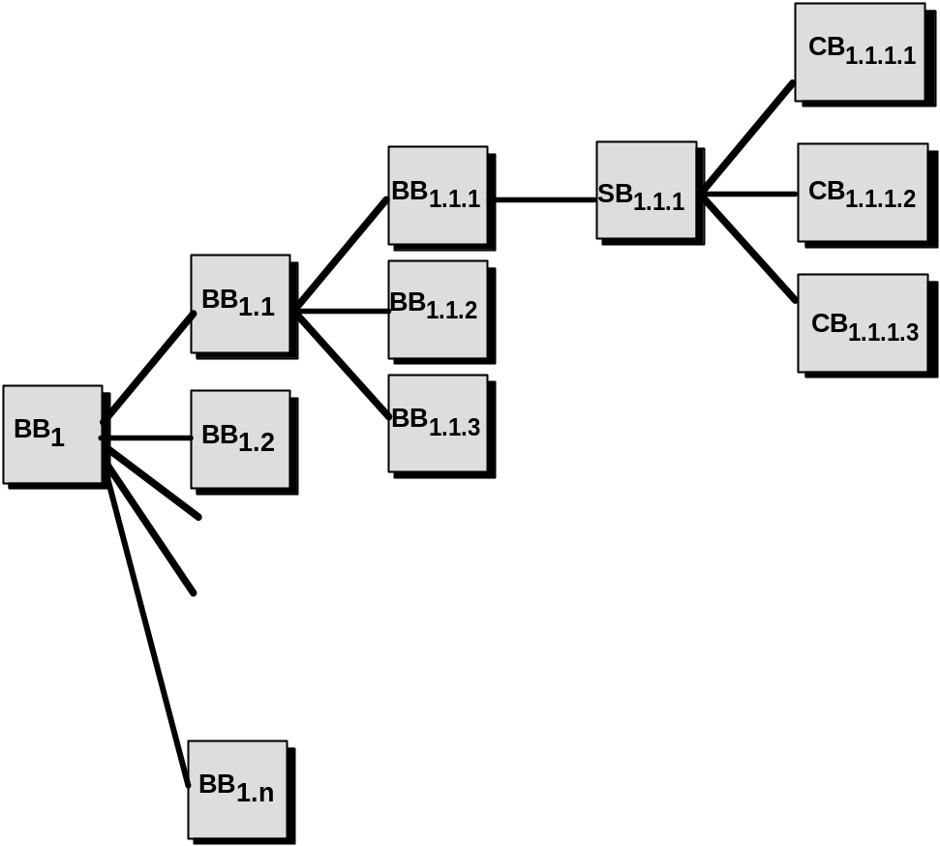
Box Structure Specification
Functional
Specification
black box
clear box
state box

Slide 10
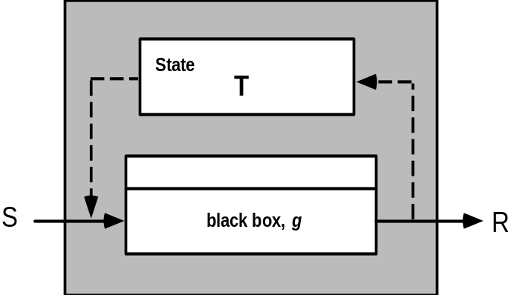
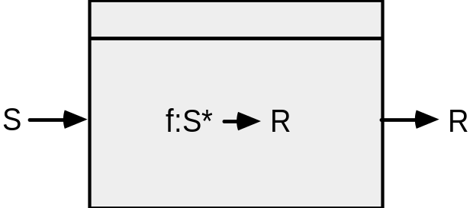
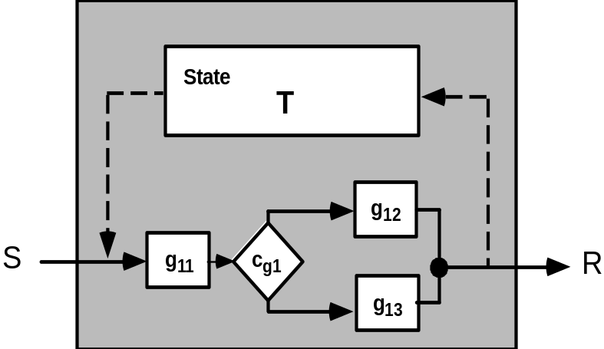
Box Structures
Functional
Specification
black box
state box
clear box

Slide 11
Design Refinement and
Verification
If a function f is expanded into a sequence g and h, the correctness condition for all input to f is:
• Does g followed by h do f?
When a function f is refined into a conditional (if-then-else), the correctness condition for all input to f is:
• Whenever condition <c> is true does g do f and whenever <c> is false, does h do f?
When function f is refined as a loop, the correctness conditions for all input to f is:
• Is termination guaranteed?
• Whenever <c> is true does g followed by f do f, and whenever <c> is false, does skipping the loop still do f?

Slide 12
Advantages of Design Verification
Design Refinement and
Verification
It reduces verification to a finite process.
It lets cleanroom teams verify every line of design and code.
It results in a near zero defect level.
It scales up.
It produces better code than unit testing.

Slide 13
Cleanroom Testing
statistical use testing
  tests the actual usage of the program
determine a “usage probability distribution”
  analyze the specification to identify a set of stimuli
  stimuli cause software to change behavior
  create usage scenarios
  assign probability of use to each stimuli
  test cases are generated for each stimuli according to the usage probability distribution

Slide 14
Certification
Cleanroom Testing
1. Usage scenarios must be created.
2. A usage profile is specified.
3. Test cases are generated from the profile.
4. Tests are executed and failure data are recorded and analyzed.
5. Reliability is computed and certified.

Slide 15
Certification Models
Cleanroom Testing
Sampling model. Software testing executes m random test cases and is certified if no failures or a specified numbers of failures occur. The value of m is derived mathematically to ensure that required reliability is achieved.
Component model. A system composed of n components is to be certified. The component model enables the analyst to determine the probability that component i will fail prior to completion.
Certification model. The overall reliability of the system is projected and certified.

Slide 16
Formal Methods
“Formal methods used in developing computer systems are mathematically based techniques for describing system properties. Such formal methods provide frameworks within which people can specify, develop, and verify systems in a systematic, rather than ad hoc manner.”
The Encyclopedia of Software Engineering [Mar01]
The Problem with conventional specs:
  contradictions
  ambiguities
  vagueness
  incompleteness
  mixed levels of abstraction

Slide 17
Formal Specification
Formal Methods
Desired properties—consistency, completeness, and lack of ambiguity—are the objectives of all specification methods
The formal syntax of a specification language enables requirements or design to be interpreted in only one way, eliminating ambiguity that often occurs when a natural language (e.g., English) or a graphical notation must be interpreted
  The descriptive facilities of set theory and logic notation enable clear statement of facts (requirements).
Consistency is ensured by mathematically proving that initial facts can be formally mapped (using inference rules) into later statements within the specification.

Slide 18
Formal Methods Concepts
Formal Methods
data invariant—a condition that is true throughout the execution of the system that contains a collection of data
state
  Many formal languages, such as OCL , that is, a system can be in one of several states, each representing an externally observable mode of behavior.
  The Z language defines a state as the stored data which a system accesses and alters
operation—an action that takes place in a system and reads or writes data to a state
  precondition defines the circumstances in which a particular operation is valid
  postcondition defines what happens when an operation has completed its action

Slide 19
The Software Configuration
programs
documents
The pieces
data

Slide 20
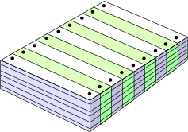
What Are These Changes?
The Software Configuration
changes in
business requirements
changes in
technical requirements
changes in
user requirements
other
documents
software models
Project
Plan
data
Test
code

Slide 21
Baselines
The Software Configuration
The IEEE (IEEE Std. No. 610.12-1990) defines a baseline as:
  A specification or product that has been formally reviewed and agreed upon, that thereafter serves as the basis for further development, and that can be changed only through formal change control procedures.
a baseline is a milestone in the development of software that is marked by the delivery of one or more software configuration items and the approval of these SCIs that is obtained through a formal technical review

Slide 22
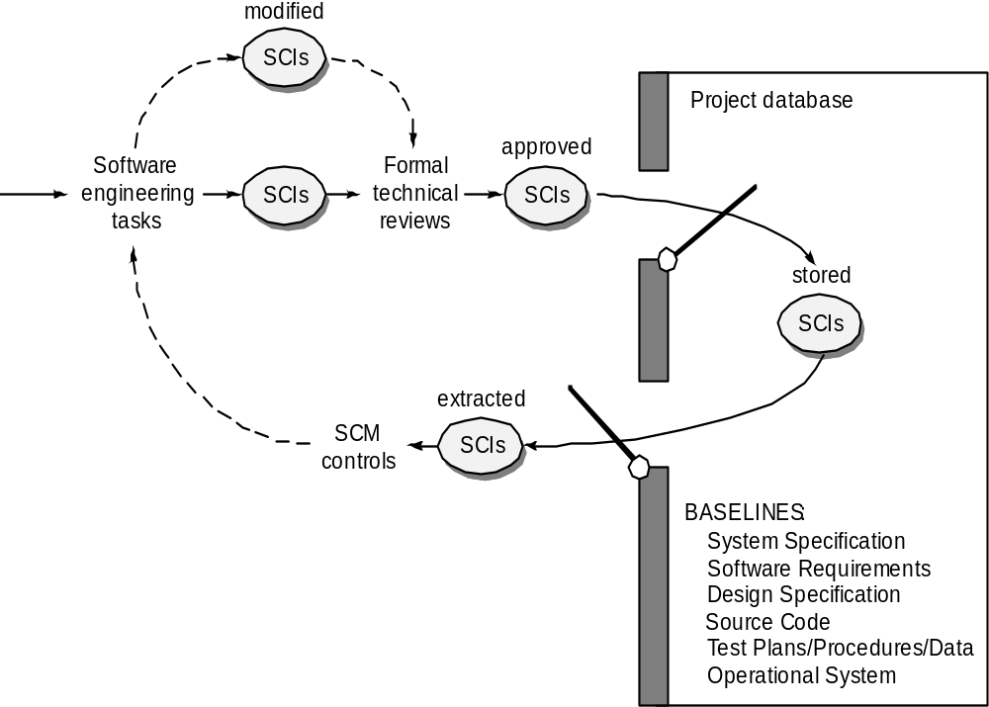
Baselined SCIs and the project database
The Software Configuration

Slide 23
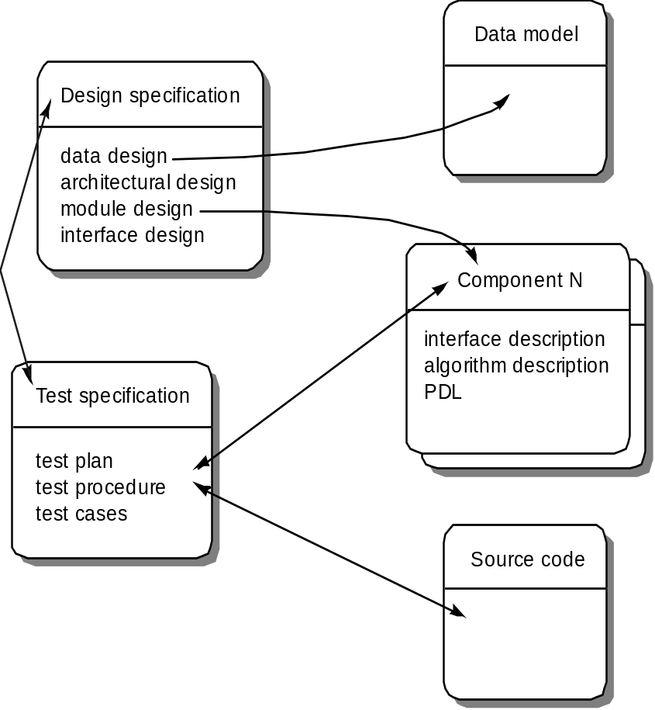
Configuration Objects
The Software Configuration

Slide 24
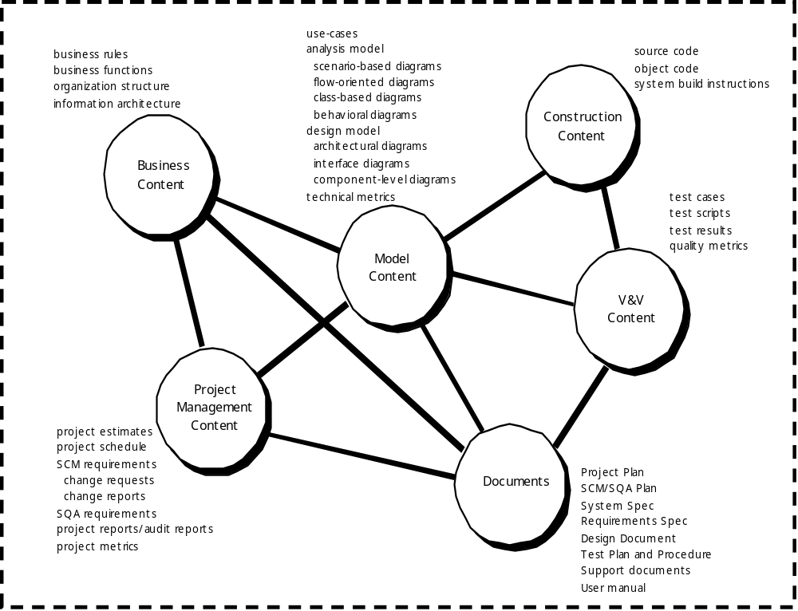
Repository Content
The Software Configuration

Slide 25
Repository Features
The Software Configuration
Versioning.
  saves all of these versions to enable effective management of product releases and to permit developers to go back to previous versions
Dependency tracking and change management.
  The repository manages a wide variety of relationships among the data elements stored in it.
Requirements tracing.
  Provides the ability to track all the design and construction components and deliverables that result from a specific requirement specification
Configuration management.
  Keeps track of a series of configurations representing specific project milestones or production releases. Version management provides the needed versions, and link management keeps track of interdependencies.
Audit trails.
  establishes additional information about when, why, and by whom changes are made.

Slide 26
SCM Elements
The Software Configuration
Component elements—a set of tools coupled within a file management system (e.g., a database) that enables access to and management of each software configuration item.
Process elements—a collection of procedures and tasks that define an effective approach to change management (and related activities) for all constituencies involved in the management, engineering and use of computer software.
Construction elements—a set of tools that automate the construction of software by ensuring that the proper set of validated components (i.e., the correct version) have been assembled.
Human elements—to implement effective SCM, the software team uses a set of tools and process features (encompassing other CM elements)

Slide 27
The SCM Process
Addresses the following questions …
How does a software team identify the discrete elements of a software configuration?
How does an organization manage the many existing versions of a program (and its documentation) in a manner that will enable change to be accommodated efficiently?
How does an organization control changes before and after software is released to a customer?
Who has responsibility for approving and ranking changes?
How can we ensure that changes have been made properly?
What mechanism is used to appraise others of changes that are made?

Slide 28

The SCM Process

Slide 29
Version Control
The SCM Process
Version control combines procedures and tools to manage different versions of configuration objects that are created during the software process
A version control system implements or is directly integrated with four major capabilities:
  a project database (repository) that stores all relevant configuration objects
  a version management capability that stores all versions of a configuration object (or enables any version to be constructed using differences from past versions);
  a make facility that enables the software engineer to collect all relevant configuration objects and construct a specific version of the software.
  an issues tracking (also called bug tracking) capability that enables the team to record and track the status of all outstanding issues associated with each configuration object.

Slide 30
Change Control Process—I
The SCM Process
Need for change is recognized
Change request from user
Developer evaluates
Change report is generated
Change control authority decides
Request is queued for action
Change request is denied
Change control process—II
User is informed

Slide 31
Change Control Process-II
The SCM Process
Request is queued for action
Assign individuals to configuration objects
“Check-out” configuration objects
Make the change
Review (audit )the change
“Check in” the configuration items that have been changed
Establish a baseline for testing
change control process—III

Slide 32
Change Control Process-III
The SCM Process
Perform quality assurance and testing activities
“Promote” changes for inclusion in next release (revision)
Rebuild appropriate version of software
Review (audit) the change to all configuration items
Include changes in new version
Distribute the new version

Slide 33
Configuration Management for Web and MobileApps
Content.
  A typical Web an MobileApp contains a vast array of content—text, graphics, applets, scripts, audio/video files, forms, active page elements, tables, streaming data, and many others.
  The challenge is to organize this sea of content into a rational set of configuration objects and then establish appropriate configuration control mechanisms for these objects.
People.
  Because a significant percentage of Web and MobileApp development continues to be conducted in an ad hoc manner, any person involved in the Web and MobileApp can (and often does) create content.

Slide 34
Configuration Management for Web and MobileApps
Scalability.
  As size and complexity grow, small changes can have far-reaching and unintended affects that can be problematic. Therefore, the rigor of configuration control mechanisms should be directly proportional to application scale.
Politics.
  Who ‘owns’ a Web and MobileApp?
  Who assumes responsibility for the accuracy of the information on the Web and MobileApp?
  Who assures that quality control processes have been followed before information is published to the site?
  Who is responsible for making changes?
  Who assumes the cost of change?

Slide 35
Content Management-I
Configuration Management for Web and MobileApps
The collection subsystem encompasses all actions required to create and/or acquire content, and the technical functions that are necessary to
  convert content into a form that can be represented by a mark-up language (e.g., HTML, XML
  organize content into packets that can be displayed effectively on the client-side.
The management subsystem implements a repository that encompasses the following elements:
  Content database—the information structure that has been established to store all content objects
  Database capabilities—functions that enable the CMS to search for specific content objects (or categories of objects), store and retrieve objects, and manage the file structure that has been established for the content
  Configuration management functions—the functional elements and associated workflow that support content object identification, version control, change management, change auditing, and reporting.

Slide 36
Content Management-II
Configuration Management for Web and MobileApps
The publishing subsystem extracts from the repository, converts it to a form that is amenable to publication, and formats it so that it can be transmitted to client-side browsers. The publishing subsystem accomplishes these tasks using a series of templates.
Each template is a function that builds a publication using one of three different components [BOI02]:
  Static elements—text, graphics, media, and scripts that require no further processing are transmitted directly to the client-side
  Publication services—function calls to specific retrieval and formatting services that personalize content (using predefined rules), perform data conversion, and build appropriate navigation links.
  External services—provide access to external corporate information infrastructure such as enterprise data or “back-room” applications.

Slide 37
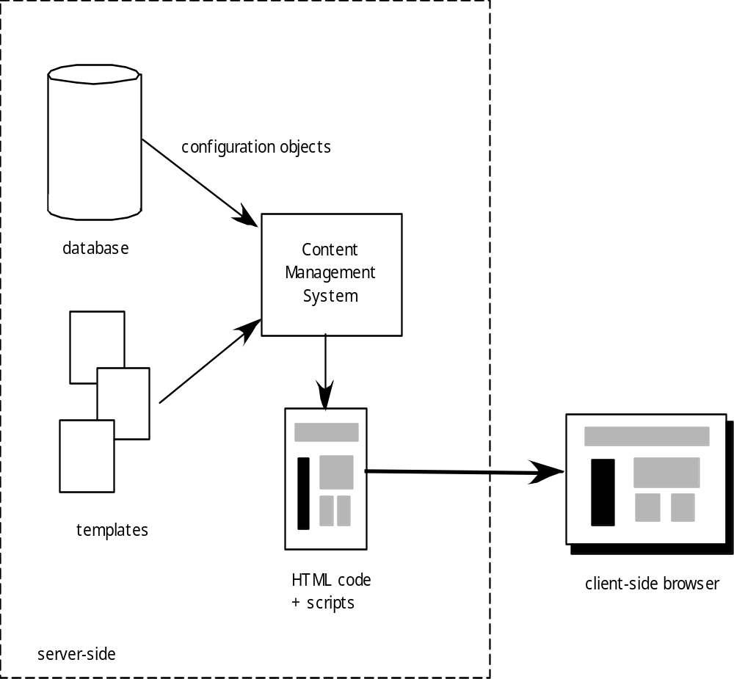
Content Management
Configuration Management for Web and MobileApps

Slide 38
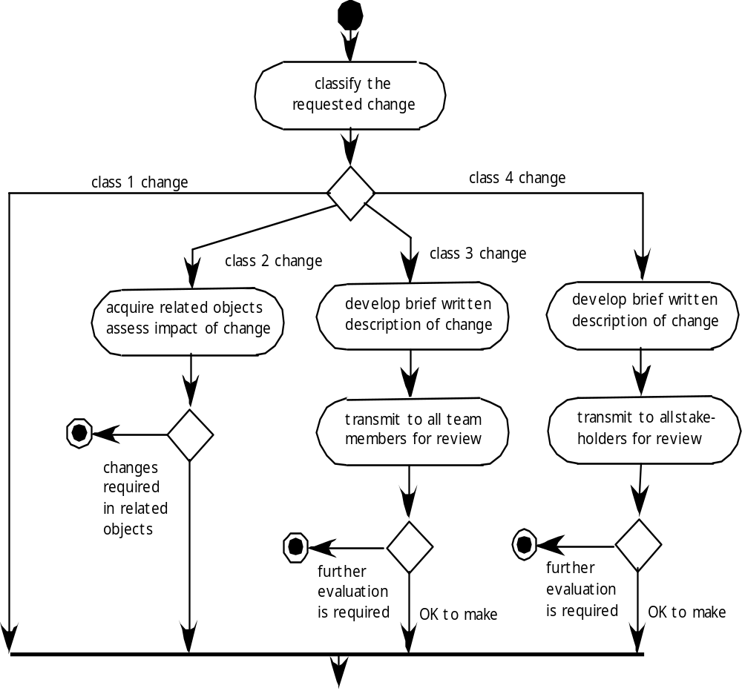
Change Management for WebApps-I
Configuration Management for Web and MobileApps

Slide 39
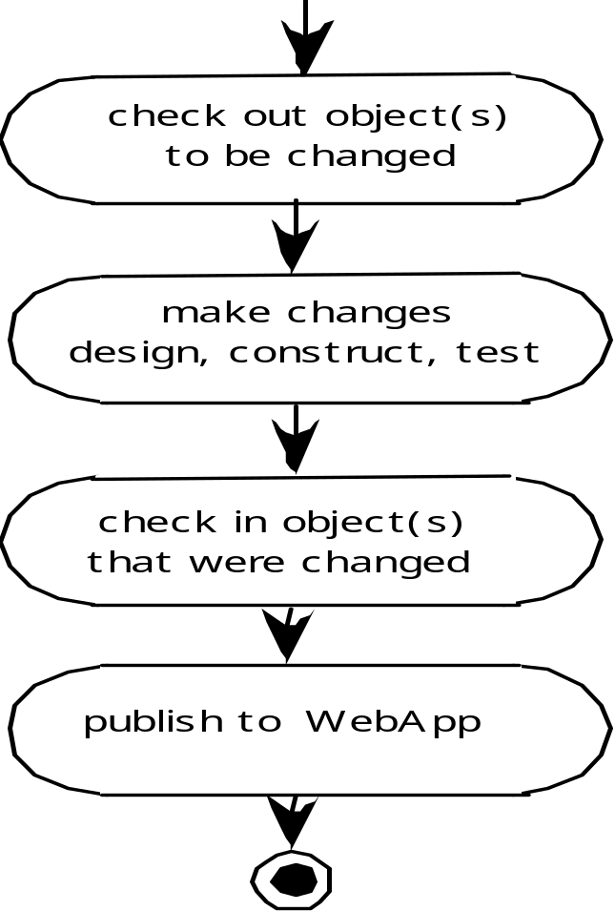
Change Management for WebApps-II
Configuration Management for Web and MobileApps

Slide 40
References
Pressman, R.S. (2015). Software Engineering : A Practioner's Approach. 8th ed. McGraw-Hill Companies.Inc, Americas, New York. ISBN : 978 1 259 253157
Formal modelling analysis
http://www.springerlink.com/content/2xedpxdgg209gdb7/
Sw configuration Management
http://www.sei.cmu.edu/reports/87cm004.pdf
Change Configuration Management
http://www.serena.com/solutions/change-and-configuration-management

Slide 41
Q & A

